Slide 1
Exploring Global Happiness with SQL
Andreas Wong
31/03/2026
NewTo Training SQL course

Slide 2
Project brief
The aim of this project is to use SQL queries to extract insights on, and create visualisations based on, the World Happiness Index 2019 dataset
The project consists of four phases:
1) Data Familiarisation
2) Analytical Queries
3) Insights and Correlations
4) Advanced queries

Slide 3
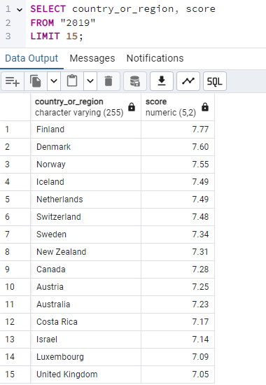
Global Happiness Rankings
According to the table, Finland has the highest happiness score. The UK ranks 15^{th.}

Slide 4
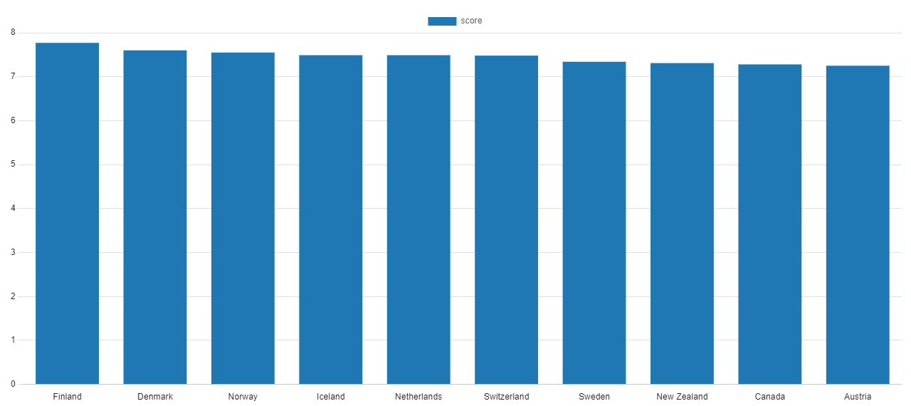
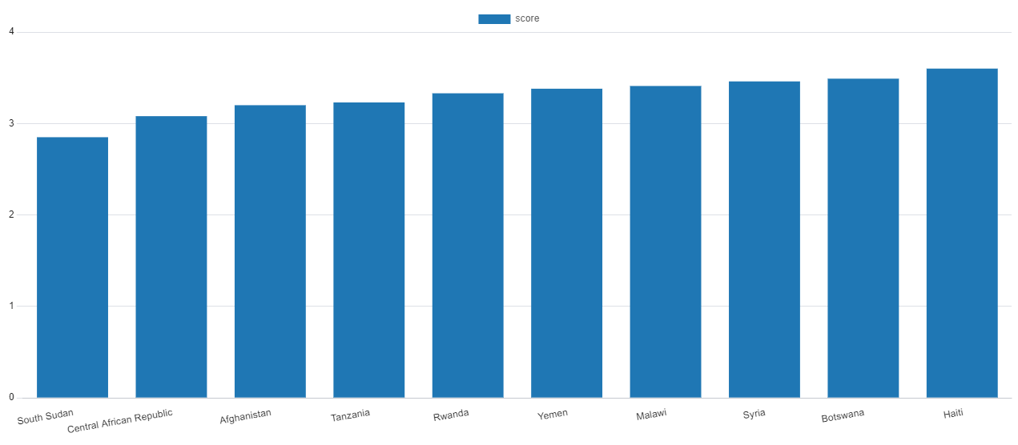
Happiest vs Unhappiest countries

Slide 5
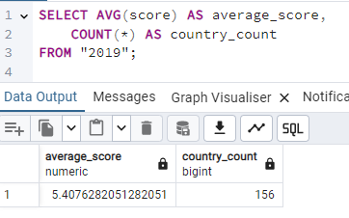
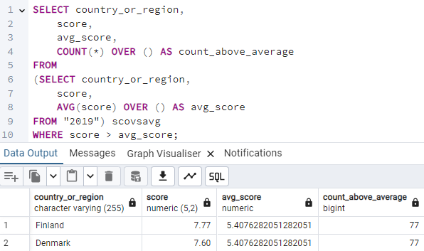
Dataset Overview + Average Global Happiness Score
There are 156 countries in this dataset.
The average score across all these countries is 5.41 (2.d.p)
Running the above code shows that 77 of the countries in the dataset have a happiness score higher than the average, meaning the remaining 79 countries have a score below the average happiness level.

Slide 6
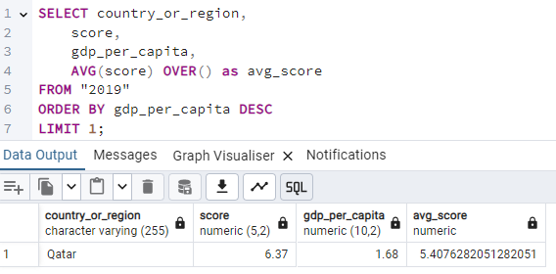
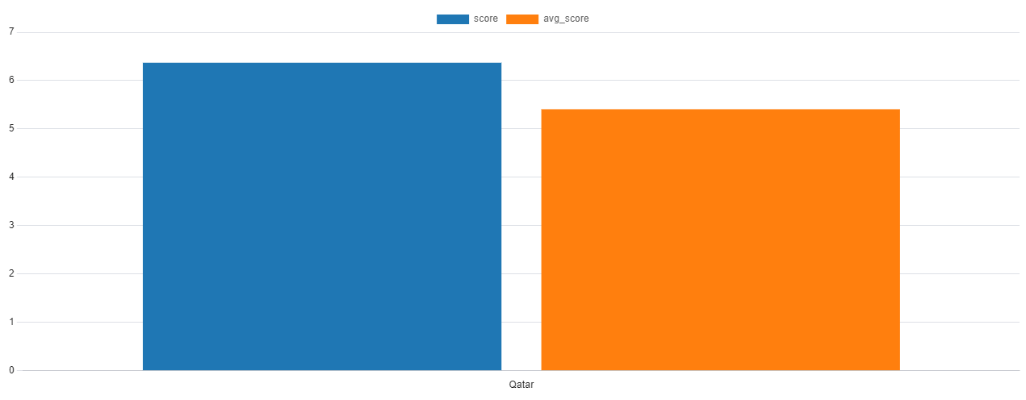
Highest GDP per capita vs global average happiness
Qatar has the highest GDP per capita, as shown on the right.
We can see that its happiness score is above the average happiness score, which we visualise in the bar chart on the below

Slide 7
Top 5 countries with the highest social support

Slide 8
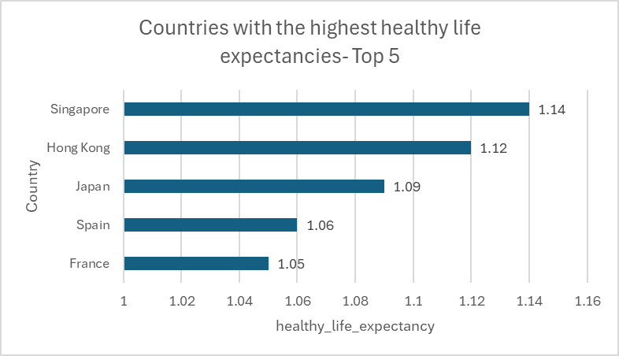
Top 5 countries with the highest healthy life expectancy
None of the top 5 countries with highest social support (previous slide), are in the top 5 countries with highest healthy life expectancy

Slide 9
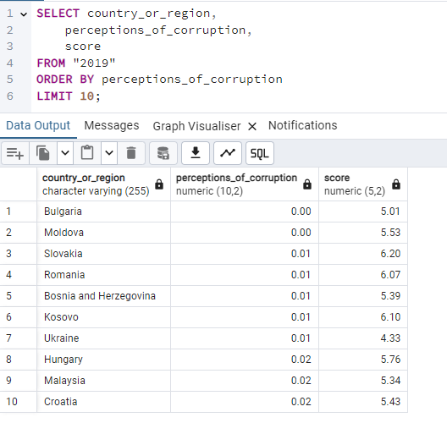
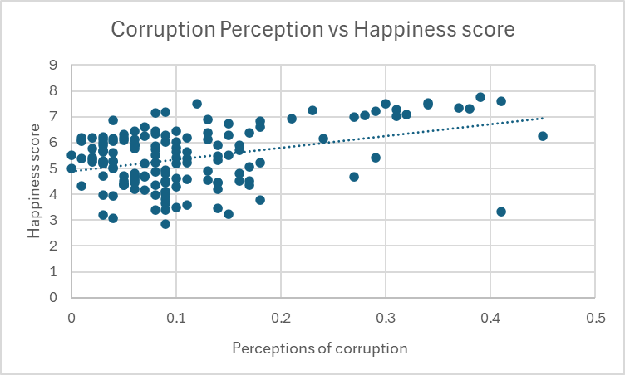
Lowest Corruption perception countries and their happiness scores
If we remember from one of the previous slides, the average happiness score across the dataset was 5.41 (2.d.p).
We can see on the table that 6 of the 10 countries with the lowest perceptions of corruption are above this average. However, such a small sample isn’t enough to see if there is correlation between low corruption perception and high happiness, so on the right is a scatter plot with all countries included:
We can see here that there is a slightly positive correlation between perceptions of corruption and happiness score, but it is not very strong.

Slide 10
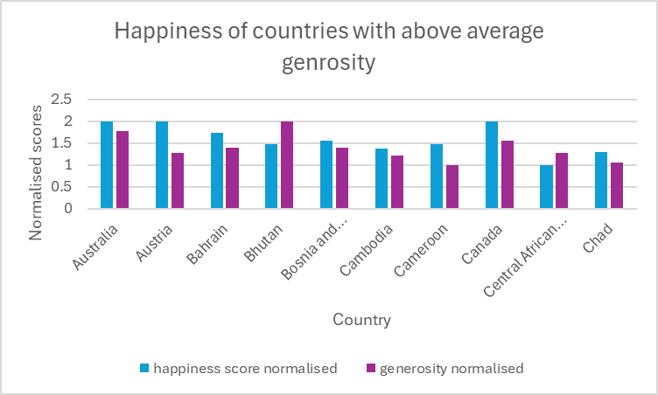
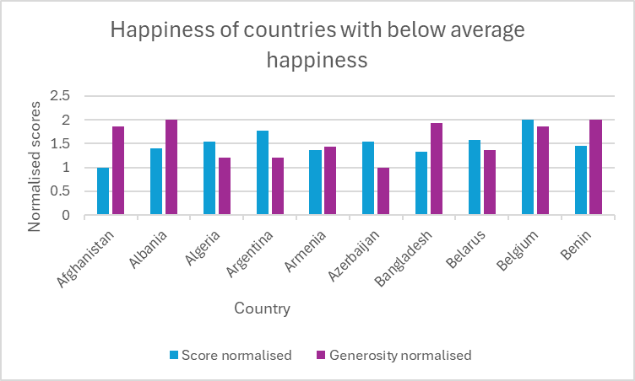
Generosity vs happiness correlation
Please bear in mind that the happiness and generosity values have been normalised, or else the scale of the axis would have been very unbalanced.
(The average generosity is 0.185 3dp)
By running some SQL code, I determined the average happiness of countries with above average generosity to be 5.46, whereas for below average generosity countries, it was 5.38, which is lower. However, I will explain on the next slide why this isn’t enough to check correlation between generosity and happiness.

Slide 11
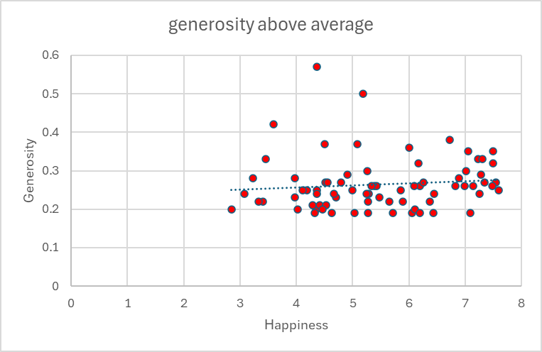
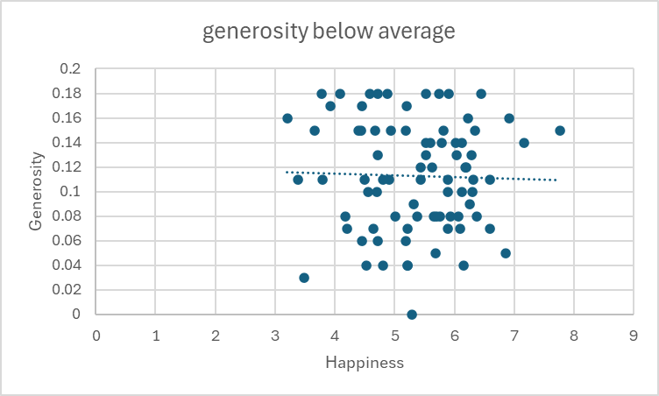
Generosity vs happiness correlation (continued)
Looking at both scatterplots, we can see that for both groups, there is almost no correlation between happiness and generosity.

Slide 12
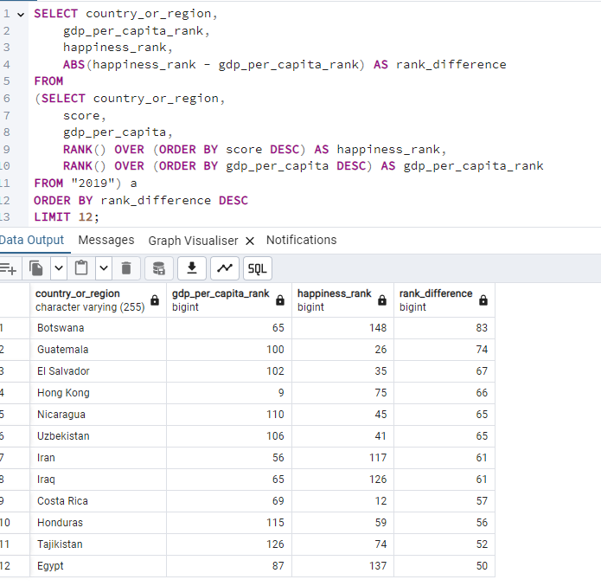
Countries with largest difference between GDP rank and happiness rank
I decided that the biggest outliers would be countries with a difference of 50 or more, which are displayed in the table.
Botswana have a relatively high GDP rank but one of the lowest happiness scores, whereas Guatemala and El Salvador have a low GDP rank but are among the happiest countries.

Slide 13
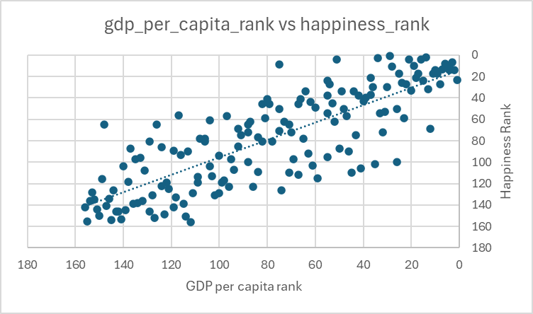
Comparing GDP per capita ranking vs Happiness ranking
We can see from the scatterplot that there is a strong correlation between happiness rank and GDP per capita rank. That is, in general, those countries with high GDP per capita rank also rank highly in their happiness score.

Slide 14
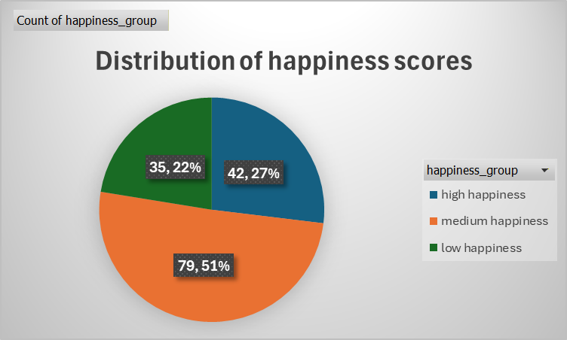
Categorising into High/Medium/Low Happiness groups
For this, I am going to class countries with a score above 6.13 as High happiness, countries with a score between 4.5 and 6.13 as medium happiness, and countries with a score lower than 4.5 are classed as low happiness.
In the pie chart, we can see that over half the countries (51%) are classed in the medium happiness group.

Slide 15
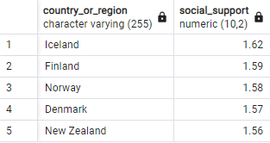
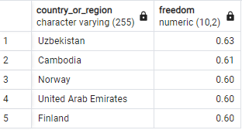
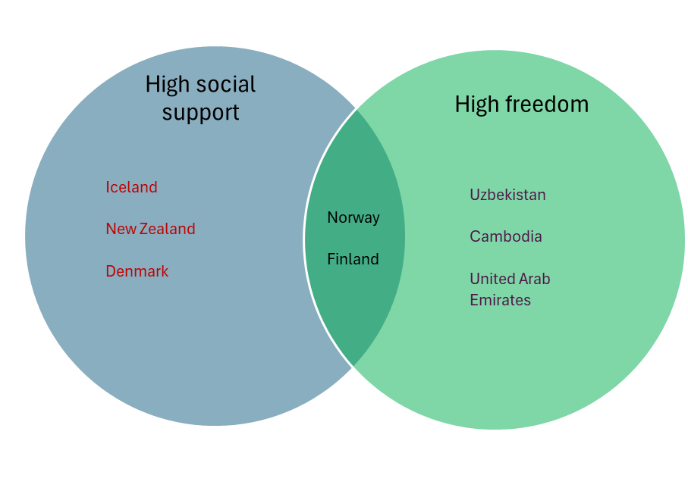
Top 5 countries with high social support and freedom
Norway and Finland both rank in the top 5 for social support AND freedom.

Slide 16
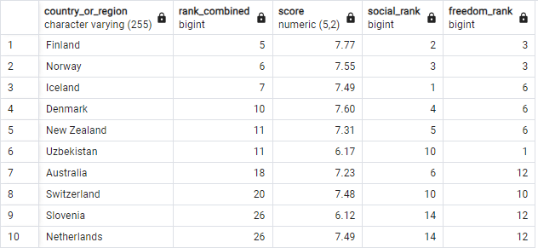
Extra
Following from the last slide, I used the rank function to see which countries had the best combined rank for social support and freedom.
This table shows the top 10 countries with the best combined rank for social support and freedom. All 10 of them also have above the average happiness.
Also, 9 out of 10 of them would be categorised in the “high happiness” group, with Slovenia being below the threshold by 0.02!

Slide 17
Key findings
Based on the data, there does not seem to be any correlation between happiness and generosity as one might initially assume.
There is a strong correlation between high GDP per capita and high happiness, although notable outliers include Botswana and Guatemala (elaboration in slide 12)
Countries with *both* high social support and high freedom seem to have high degrees of happiness
None of the top 5 countries with the highest healthy life expectancy are ranked in the top 15 for happiness score

Slide 18
Conclusion
From these findings, if policymakers focused on policies which would improve GDP per capita, and put more money into social support, they could see an increase in happiness in their countries.
Outliers like Botswana (high GDP, low happiness) and Guatemala (low GDP, high happiness) should be studied to see which other factors can affect happiness.

